Slide 1

An Efficient GPU Implementation of a Tree-based n-Body Algorithm
Martin Burtscher
Department of Computer Science

Slide 2
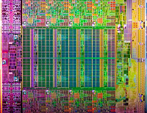
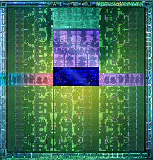
High-end CPU-GPU Comparison
  Xeon E5-2687W Kepler GTX 680
  Cores 8 (superscalar) 1536 (simple)
  Active threads 2 per core ~11 per core
  Frequency 3.1 GHz 1.0 GHz
  Peak performance (SP) 397 GFlop/s 3090 GFlop/s
  Peak mem. bandwidth 51 GB/s 192 GB/s
  Maximum power 150 W 195 W*
  Price $1900 $500*
  Release dates
    Xeon: March 2012
    Kepler: March 2012
  *entire card
Intel
Nvidia

Slide 3
GPU Advantages
Performance
  8x as many operations executed per second
Main memory bandwidth
  4x as many bytes transferred per second
Cost-, energy-, and size-efficiency
  29x as much performance per dollar
  6x as much performance per watt
  11x as much performance per area
(based on peak values)

Slide 4
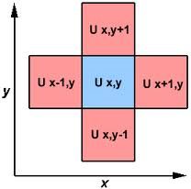
GPU Disadvantages
Clearly, we should use GPUs all the time
  So why aren’t we?
GPUs are harder to program and tune than CPUs
  Easy to make performance mistakes
GPUs can only execute some types of code fast
  Need lots of data parallelism, data reuse, & regularity
Mostly regular codes have been ported to GPUs
  E.g., matrix codes executing many ops/word
    Dense matrix operations, stencil codes (PDEs)
LLNL

Slide 5
GPU Disadvantages
Clearly, we should use GPUs all the time
  So why aren’t we?
GPUs are harder to program and tune than CPUs
  Easy to make performance mistakes
GPUs can only execute some types of code fast
  Need lots of data parallelism, data reuse, & regularity
Mostly regular codes have been ported to GPUs
  E.g., matrix codes executing many ops/word
    Dense matrix operations, stencil codes (PDEs)
Our goal is to also handle irregular codes well
LLNL

Slide 6
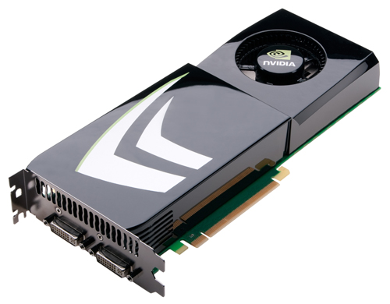
Outline
Introduction
GPU programming
Barnes Hut algorithm
CUDA implementation
Experimental results
Conclusions

Slide 7
CUDA Programming Model
Non-graphics programming
  Uses GPU as massively parallel co-processor
  Thousands of threads needed for full efficiency
C/C++ with extensions
  Kernel launch
    Calling functions on GPU
  Memory management
    GPU memory allocation, copying data to/from GPU
  Declaration qualifiers
    Device, shared, local, etc.
  Special instructions
    Barriers, fences, etc.
  Keywords
    threadIdx, blockIdx
CPU
PCI-Express
bus
GPU

Slide 8
Calling GPU Kernels
Kernels are functions that run on the GPU
  Callable by CPU code
  CPU can continue processing while GPU runs kernel
  KernelName<<<m, n>>>(arg1, arg2, ...);
Launch configuration (programmer selectable)
  GPU spawns m blocks with n threads (i.e., m*n threads total) that run a copy of the same function
  Normal function parameters: passed conventionally
    Different address space, should never pass CPU pointers

Slide 9
GPU Architecture
GPUs consist of Streaming Multiprocessors (SMs)
  1 to 30 SMs per chip (run blocks)
SMs contain Processing Elements (PEs)
  8, 32, or 192 PEs per SM (run threads)
Shared
Memory
Shared
Memory
Shared
Memory
Shared
Memory
Shared
Memory
Shared
Memory
Shared
Memory
Shared
Memory
Global Memory
Adapted from NVIDIA

Slide 10
Block Scalability
Hardware can assign blocks to SMs in any order
  A kernel with enough blocks scales across GPUs
  Not all blocks may be resident at the same time
GPU with 2 SMs
Kernel
Block 0
Block 1
GPU with 4 SMs
Block 2
Block 3
Block 0
Block 1
Block 4
Block 5
Block 6
Block 7
Block 0
Block 1
Block 2
Block 3
Block 2
Block 3
time
Block 4
Block 5
Block 6
Block 7
Block 4
Block 5
Adapted from NVIDIA
Block 6
Block 7

Slide 11
GPU Memories
GPU
Separate from CPU memory
  CPU can access GPU’s global & constant mem. via PCIe bus
  Requires slow explicit transfer
Visible GPU memory types
  Registers (per thread)
  Local mem. (per thread)
  Shared mem. (per block)
    Software-controlled cache
  Global mem. (per kernel)
  Constant mem. (read only)
  Slow communic. between blocks
Block (0, 0)
Block (1, 0)
Shared Memory (SRAM)
Shared Memory (SRAM)
Registers
Registers
Registers
Registers
Thread (0, 0)
Thread (1, 0)
Thread (0, 0)
Thread (1, 0)
CPU
Global + Local Memory (DRAM)
Constant Memory (DRAM, cached)
Adapted from NVIDIA

Slide 12
SM Internals (Fermi and Kepler)
Caches
  Software-controlled shared memory
  Hardware-controlled incoherent L1 data cache
  64 kB combined size, can be split 16/48, 32/32, 48/16
Synchronization support
  Fast hardware barrier within block (__syncthreads())
  Fence instructions: memory consistency & coherency
Special operations
  Thread voting (warp-based reduction operations)

Slide 13
Block and Thread Allocation Limits
Blocks assigned to SMs
  Until first limit reached
Threads assigned to PEs
Hardware limits
  8/16 active blocks/SM
  1024, 1536, or 2048 resident threads/SM
  512 or 1024 threads/blk
  16k, 32k, or 64k regs/SM
  16 kB or 48 kB shared memory per SM
  2¹⁶-1 or 2³¹-1 blks/kernel
SM 0
SM 1
t0 t1 t2 … tm
MT IU
MT IU
t0 t1 t2 … tm
PE
PE
Blocks
Blocks
Shared
Memory
Shared
Memory
Adapted from NVIDIA

Slide 14
Warp-based Execution
32 contiguous threads form a warp
  Execute same instruction in same cycle (or disabled)
  Warps are scheduled out-of-order with respect to each other to hide latencies
Thread divergence
  Some threads in warp jump to different PC than others
  Hardware runs subsets of warp until they re-converge
  Results in reduction of parallelism (performance loss)

Slide 15
Thread Divergence
Non-divergent code
  if (threadID >= 32) {
  some_code;
  } else {
  other_code;
  }
Divergent code
  if (threadID >= 13) {
  some_code;
  } else {
  other_code;
  }
Thread ID:
0 1 2 3 … 31
Thread ID:
0 1 2 3 … 31
disabled
disabled
Adapted from NVIDIA
Adapted from NVIDIA

Slide 16
Parallel Memory Accesses
Coalesced main memory access (32x faster)
  Under some conditions, HW combines multiple warp memory accesses into a single coalesced access
    128-byte aligned 128-byte line (cached)
Bank-conflict-free shared memory access (32x)
  No superword alignment or contiguity requirements
    32 different banks + 1-word broadcast each

Slide 17
Coalesced Main Memory Accesses
single coalesced access one and two coalesced accesses*
NVIDIA NVIDIA

Slide 18
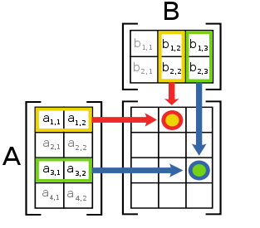
Regular Programs
Typically operate on arrays and matrices
  Data is processed in fixed-iteration FOR loops
Have statically predictable behavior
  Exhibit mostly strided memory access patterns
  Control flow is mainly determined by input size
  Data dependencies are static and not loop carried
Example
  for (i = 0; i < size; i++) {
  c[i] = a[i] + b[i];
  }
wikipedia

Slide 19
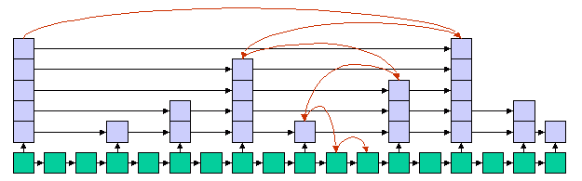
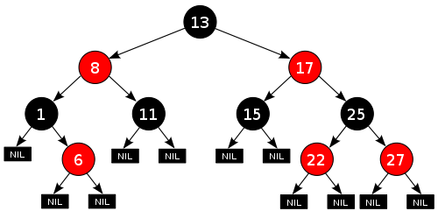
Irregular Programs
Are important and widely used
  Social network analysis, data clustering/partitioning, discrete-event simulation, operations research, meshing, SAT solving, n-body simulation, etc.
Typically operate on dynamic data structures
  Graphs, trees, linked lists, priority queues, etc.
  Data is processed in variable-iteration WHILE loops
tripod
wikipedia

Slide 20
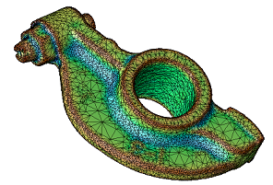
Irregular Programs (cont.)
Have statically unpredictable behavior
  Exhibit pointer-chasing memory access patterns
  Control flow depends on input values and may change
  Data dependences have to be detected dynamically
Example
  while (pos != end) {
  v = workset[pos++];
  for (i = 0; i < count[v]; i++){
  n = neighbor[index[v] + i];
  if (process(v,n)) workset[end++] = n;
  } }
LANL

Slide 21
GPU Implementation Challenges
Indirect and irregular memory accesses
  Little or no coalescing [low bandwidth]
Memory-bound pointer chasing
  Little locality and computation [exposed latency]
Dynamically changing irregular control flow
  Thread divergence [loss of parallelism]
Input dependent and changing data parallelism
  Load imbalance [loss of parallelism]
Need case studies on how to best map irreg codes

Slide 22
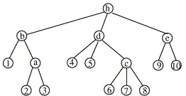
Example: N-body Simulation
Irregular Barnes Hut algorithm
  Repeatedly builds unbalanced tree and performs complex traversals on it
Our implementation
  Designed for GPUs (not just port of CPU code)
  First GPU implementation of entire BH algorithm
Results
  GPU is 21 times faster than CPU (6 cores) on this code
sciencedirect

Slide 23
Outline
Introduction
GPU programming
Barnes Hut algorithm
CUDA implementation
Experimental results
Conclusions
NASA/JPL-Caltech/SSC

Slide 24
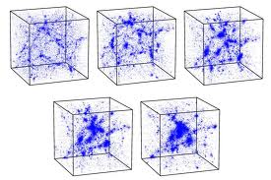

N-body Simulation
Time evolution of physical system
  System consists of bodies
  “n” is the number of bodies
  Bodies interact via pair-wise forces
Many systems can be modeled in this way
  Star/galaxy clusters (gravitational force)
  Particles (electric force, magnetic force)
RUG
Cornell

Slide 25
Barnes Hut Idea
Precise force calculation
  Requires O(n²) operations (O(n²) body pairs)
  Computationally intractable for large n
Barnes and Hut (1986)
  Algorithm to approximately compute forces
    Bodies’ initial position & velocity are also approximate
  Requires only O(n log n) operations
  Idea is to “combine” far away bodies
  Error should be small because force ∼ 1/distance²

Slide 26
Barnes Hut Algorithm
Set bodies’ initial position and velocity
Iterate over time steps
  Compute bounding box around bodies
  Subdivide space until at most one body per cell
    Record this spatial hierarchy in an octree
  Compute mass and center of mass of each cell
  Compute force on bodies by traversing octree
    Stop traversal path when encountering a leaf (body) or an internal node (cell) that is far enough away
  Update each body’s position and velocity

Slide 27
Build Tree (Level 1)
Compute bounding box around all bodies → tree root

Slide 28
Build Tree (Level 2)
Subdivide space until at most one body per cell

Slide 29
Build Tree (Level 3)
Subdivide space until at most one body per cell

Slide 30
Build Tree (Level 4)
Subdivide space until at most one body per cell

Slide 31
Build Tree (Level 5)
Subdivide space until at most one body per cell

Slide 32
Compute Cells’ Center of Mass
For each internal cell, compute sum of mass and weighted average
of position of all bodies in subtree; example shows two cells only

Slide 33
Compute Forces
Compute force, for example, acting upon green body

Slide 34
Compute Force (short distance)
Scan tree depth first from left to right; green portion already completed

Slide 35
Compute Force (down one level)
Red center of mass is too close, need to go down one level

Slide 36
Compute Force (long distance)
Blue center of mass is far enough away

Slide 37
Compute Force (skip subtree)
Therefore, entire subtree rooted in the blue cell can be skipped

Slide 38
Pseudocode
bodySet = ...
foreach timestep do {
bounding_box = new Bounding_Box();
foreach Body b in bodySet {
bounding_box.include(b);
}
octree = new Octree(bounding_box);
foreach Body b in bodySet {
octree.Insert(b);
}
cellList = octree.CellsByLevel();
foreach Cell c in cellList {
c.Summarize();
}
foreach Body b in bodySet {
b.ComputeForce(octree);
}
foreach Body b in bodySet {
b.Advance();
}
}

Slide 39
Complexity and Parallelism
bodySet = ...
foreach timestep do { // O(n log n) + ordered sequential
bounding_box = new Bounding_Box();
foreach Body b in bodySet { // O(n) parallel reduction
bounding_box.include(b);
}
octree = new Octree(bounding_box);
foreach Body b in bodySet { // O(n log n) top-down tree building
octree.Insert(b);
}
cellList = octree.CellsByLevel();
foreach Cell c in cellList { // O(n) + ordered bottom-up traversal
c.Summarize();
}
foreach Body b in bodySet { // O(n log n) fully parallel
b.ComputeForce(octree);
}
foreach Body b in bodySet { // O(n) fully parallel
b.Advance();
}
}

Slide 40
Outline
Introduction
GPU programming
Barnes Hut algorithm
CUDA implementation
Experimental results
Conclusions

Slide 41
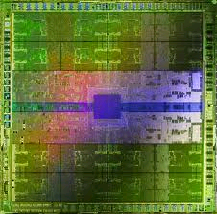
Efficient GPU Code
Large amounts of data parallelism
Coalesced main memory accesses
Little thread divergence
Relatively little synchronization between blocks
Little CPU/GPU data transfer
Efficient use of shared memory
Thepcreport.net

Slide 42
Main BH Implementation Challenges
Uses irregular tree-based data structure
  Initially little parallelism
  Little coalescing
  Load imbalance
Complex recursive traversals
  Recursion not well supported
  Lots of thread divergence
Memory-bound pointer-chasing operations
  Not enough computation to hide latency

Slide 43
Six GPU Kernels
Read initial data and transfer to GPU
for each timestep do {
  Compute bounding box around bodies (not irregular)
  Build hierarchical decomposition, i.e., octree
  Summarize body information in internal octree nodes
  Approximately sort bodies by spatial location (optional)
  Compute forces acting on each body with help of octree
  Update body positions and velocities (not irregular)
}
Transfer result from GPU and output

Slide 44
Global Optimizations
Make code iterative (recursion not supported*)
Keep data on GPU between kernel calls
Use array elements instead of heap nodes
  One aligned array per field for coalesced accesses

Slide 45
Global Optimizations (cont.)
Maximize thread count (round down to warp size)
Maximize resident block count (all SMs filled)
Pass kernel parameters through constant memory
Use special allocation order
Use index arithmetic
Persistent blocks & threads
Unroll loops over children

Slide 46
Kernel 1: Bounding Box (Regular)
Reduction operation
Optimizations
  Fully coalesced
  Fully cached
  No bank conflicts
  Minimal divergence
  Built-in min and max
  2 red/mem, 6 red/bar
  Bodies load balanced
  512*3 threads per SM

Slide 47
Kernel 2: Build Octree (Irregular)
Optimizations
  Only lock leaf “pointers”
  Lock-free fast path
  Light-weight lock release
  No re-traverse after lock acquire failure
  Combined memory fence
  Re-compute position during traversal
  Separate init kernels
  512*3 threads per SM
Top-down tree building

Slide 48
Kernel 2: Build Octree (cont.)
// initialize
cell = find_insertion_point(body); // no locks, cache cell
child = get_insertion_index(cell, body);
if (child != locked) { // skip atomic if already locked
if (child == null) { // fast path (frequent)
if (null == atomicCAS(&cell[child], null, body)) { // lock-free insertion
// move on to next body
}
} else {
if (child == atomicCAS(&cell[child], child, lock)) { // acquire lock
// build subtree with new and existing body
flag = true;
}
}
}
__syncthreads(); // optional barrier
__threadfence(); // make data visible
if (flag) {
cell[child] = new_subtree; // insert subtree and releases lock
// move on to next body
}

Slide 49
Kernel 3: Summarize Subtrees (Irreg.)
Bottom-up tree traversal
Optimizations
  Scan avoids deadlock
  Use mass as flag + fence
    No locks, no atomics
  Use wait-free first pass
  Cache the ready info
  Piggyback on traversal
    Count bodies in subtrees
  No parent “pointers”
  128*6 threads per SM

Slide 50
Kernel 4: Sort Bodies (Irregular)
Top-down tree traversal
Optimizations
  (Similar to Kernel 3)
  Scan avoids deadlock
  Use data field as flag
    No locks, no atomics
  Use counts from Kernel 3
  Piggyback on traversal
    Move nulls to back
  Throttle warps with optional barrier
  64*6 threads per SM

Slide 51
Kernel 5: Force Calculation (Irregular)
Multiple prefix traversals
Optimizations
  Group similar work together
    Uses sorting to minimize size of prefix union in each warp
    Early out (nulls in back)
  Traverse whole union to avoid divergence (warp voting)
  Lane 0 controls iteration stack for entire warp (fits in shmem)
  Minimize volatile accesses
  Use fast 1/sqrtf instruction
  256*5 threads per SM

Slide 52
Architectural Support
Coalesced memory accesses & lockstep execution
  All threads in warp read same tree node at same time
  Only one mem access per warp instead of 32 accesses
Warp-based execution
  Enables data sharing in warps w/o synchronization
RSQRTF instruction
  Quickly computes good approximation of 1/sqrtf(x)
Warp voting instructions
  Quickly perform reduction operations within a warp

Slide 53
Kernel 6: Advance Bodies (Regular)
Optimizations
  Fully coalesced, no divergence
  Load balanced, 1024*1 threads per SM
Straightforward streaming

Slide 54
Outline
Introduction
GPU programming
Barnes Hut algorithm
CUDA implementation
Experimental results
Conclusions

Slide 55
Evaluation Methodology
Implementations
  CUDA/GPU: Barnes Hut and O(n²) algorithms
  OpenMP/CPU: Barnes Hut algorithm (derived from CUDA)
  Pthreads/CPU: Barnes Hut algorithm (SPLASH-2 suite)
Systems and compilers
  nvcc 4.0 (-O3 -arch=sm_20 -ftz=true*)
  GeForce GTX 480, 1.4 GHz, 15 SMs, 32 cores per SM
  gcc 4.1.2 (-O3 -fopenmp* -ffast-math*)
  Xeon X5690, 3.46 GHz, 6 cores, 2 threads per core
Inputs and metric
  5k, 50k, 500k, and 5M star clusters (Plummer model)
  Best runtime of three experiments, excluding I/O

Slide 56
Nodes Touched per Activity (5M Input)
Kernel “activities”
  K1: pair reduction
  K2: tree insertion
  K3: bottom-up step
  K4: top-down step
  K5: prefix traversal
  K6: integration step
Max tree depth ≤ 22
Cells have 3.1 children
Prefix ≤ 6,315 nodes
(≤ 0.1% of 7.4 million)
BH algorithm & sorting to min. union work well

Slide 57
Available Amorphous Data Parallelism
bounding box tree building summarization sorting
Almost every “round” has lots of activities without data dependencies that can be processed in parallel
force calc.
integration

Slide 58
Runtime Comparison
GPU BH inefficiency
  5k input too small for 5,760 to 23,040 threads
BH vs. O(n²) algorithm
  O(n²) faster with fewer than about 15k bodies
GPU (5M input)
  21.1x faster than OpenMP
  23.2x faster than Pthreads

Slide 59
Kernel Performance for 5M Input
$200 GPU delivers 228 GFlops/s on irregular code
GPU chip is 2.7 to 23.5 times faster than CPU chip
GPU hardware is better suited for BH than CPU hw
  But difficult and very time consuming to program

Slide 60
Optimization Benefit
Optimizations that are generally applicable
Optimizations for irregular kernels

Slide 61
Outline
Introduction
GPU programming
Barnes Hut algorithm
CUDA implementation
Experimental results
Conclusions

Slide 62
Optimization Summary
Reduce main memory accesses
  Share data within warp, combine memory fences & traversals, re-compute data, avoid volatile accesses
Minimize thread divergence
  Group similar work together, force synchronicity
Implement entire algorithm on and for GPU
  Avoid data transfers & data structure inefficiencies, wait-free pre-pass, scan entire prefix union

Slide 63
Optimization Summary (cont.)
Exploit hardware features
  Fast synchronization & thread startup, special instrs., coalesced memory accesses, even lockstep execution
Use light-weight locking and synchronization
  Minimize locks, reuse fields, and use fence + store ops
Maximize parallelism
  Parallelize every step within and across SMs

Slide 64
Conclusions
Irregularity does not necessarily prevent high-performance on GPUs
  Entire Barnes Hut algorithm implemented on GPU
    Builds and traverses unbalanced octree
  GPU is 21.1 times (float) and 9.1 times (double) faster than high-end 6-core Xeon
Code directly for GPU, do not merely adjust CPU code
  Requires different data and code structures
  Benefits from different algorithmic modifications

Slide 65
Acknowledgments
Collaborators
  Prof. Keshav Pingali (University of Texas at Austin)
  Ricardo Alves (Universidade do Minho, Portugal)
Hardware and funding
  NVIDIA Corporation
  National Science Foundation (1141022, 1406304)

