Slide 1


Compressed In-memory Graphs for Accelerating GPU-based Graph Analytics
Noushin Azami and Martin Burtscher
Department of Computer Science

Slide 2
Compressed In-memory Graphs for Accelerating GPU-based Analytics
Noushin Azami and Martin Burtscher
Department of Computer Science

Slide 3
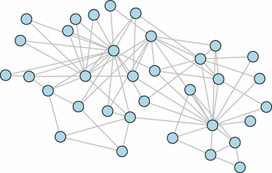
Introduction
Graph analytics codes are widely used
  Mostly irregular
  Process large graphs
  Memory accesses are performance bottleneck
Using compressed in-memory representation
  Can speed up memory accesses
  Requires extra computation to decompress
Hard to reap benefit on GPUs due to fast memory
  Our solution: Massively Parallel Log Graph (MPLG)

Slide 4

Contributions
Compressed in-memory graph representation
  First to run GPU graph codes on compressed graphs
  Can fit 20% to 70% larger graphs
Massively parallel decompression
  High throughput
  Low latency
  Thread, warp, block, and hybrid versions
MPLG accelerates fastest GPU graph algorithms

Slide 5
Related Work: LIGRA+ (DCC 2015)
Interface
Graph
Use compressed representation
Vertex Subset
Edge Map
Decode edges on-the-fly
Vertex Map
Parallel over vertices, divides up high-degree vertices
Only on CPUs, not enough parallelism for GPUs
Only applicable to LIGRA codes

Slide 6
CSR Graph Representation
1
Compressed Sparse Row (CSR)
Widely used graph representation
Index: start location of adjacency lists
Edge: concatenated adjacency lists
MPLG compresses (larger) edge array
0: {1, 2, 3}
1: {2}
2: {}
3: {0, 1}
0
2
3
0
1
2
3
4
5
6
Edge
1 | 2 | 3 | 2 | 0 | 1
Ø
Index
0 | 3 | 4 | 4 | 6
Vertex
0
1
2
3

Slide 7






MPLG Log Encoding
Reduce storage of integer values in edge array
  Eliminate fixed number of leading zero bits
  Enables independent decoding of each value
$$a=1081$$
$$b=1027$$
$$c=13610$$
00000000000000000000010000111001
00000000000000000000010000000011
00000000000000000011010100101010
00010000111001 00010000000011 1101
0100101010
$$a$$
$$b$$
$$c$$

Slide 8

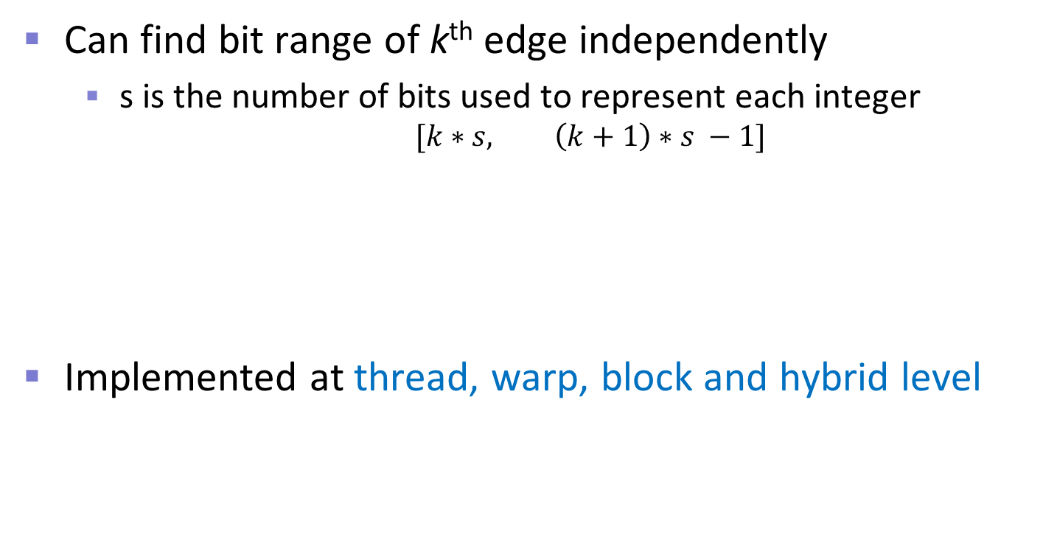




MPLG Log Decoding
Can find bit range of k^{th} edge independently
  s is the number of bits used to represent each integer
  $$[k∗s, \left(k+1\right)∗s −1]$$
Implemented at thread, warp, block and hybrid level
example
s = 14
k = 1
$$14$$
2$7$
00010000111001 00010000000011 1101
0100101010
$$a$$
$$b$$
$$c$$

Slide 9
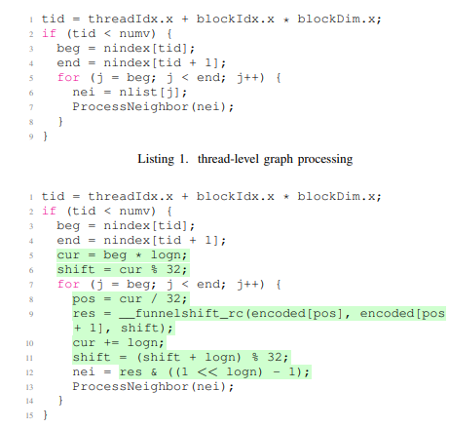
MPLG Log Decoding, Thread-level
On-the-fly decompression
Parallel across adj lists
No synchronization needed
Requires just a few machine instructions
concatenates bits of 2 ints and shifts them

Slide 10
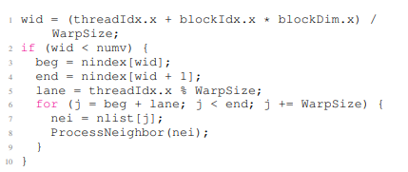
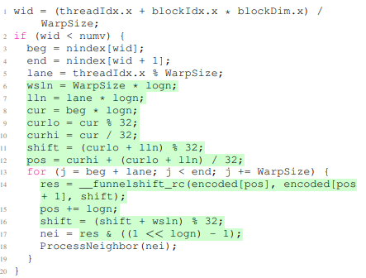
MPLG Log Decoding, Warp-level

Slide 11
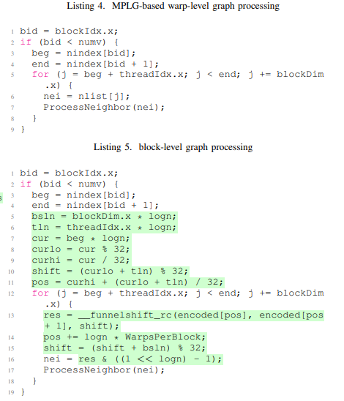
MPLG Log Decoding, Block-level

Slide 12
MPLG-enhanced Codes
High-performance GPU codes from
Gardenia, Rodinia, and ECL benchmark suites
  BFS: Rodinia (thread level)
  CC: Gardenia (thread and warp level), ECL (hybrid)
  GC: ECL (hybrid)
  MIS: ECL (thread level)
  MST: Gardenia (thread level)
  SSSP: Gardenia (thread level)

Slide 13
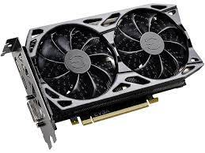
Evaluation Method
System 1
  Ryzen Threadripper 2950X CPU with 16 HT cores
  TITAN V GPU
    80 SMs, 96 kB/SM L1 cache, 4.5 MB L2 cache, 12 GB global memory, 652 GB/s peak memory bandwidth
System 2
  Xeon Gold 6226R CPU with 32 HT cores
  RTX 3090 GPU
    82 SMs, 128 kB/SM L1 cache, 6 MB L2 cache, 24 GB global memory, 936 GB/s peak memory bandwidth

Slide 14
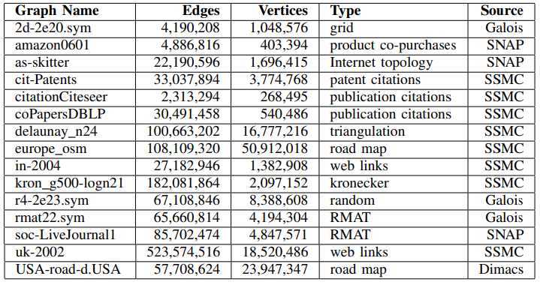
Input Graphs

Slide 15
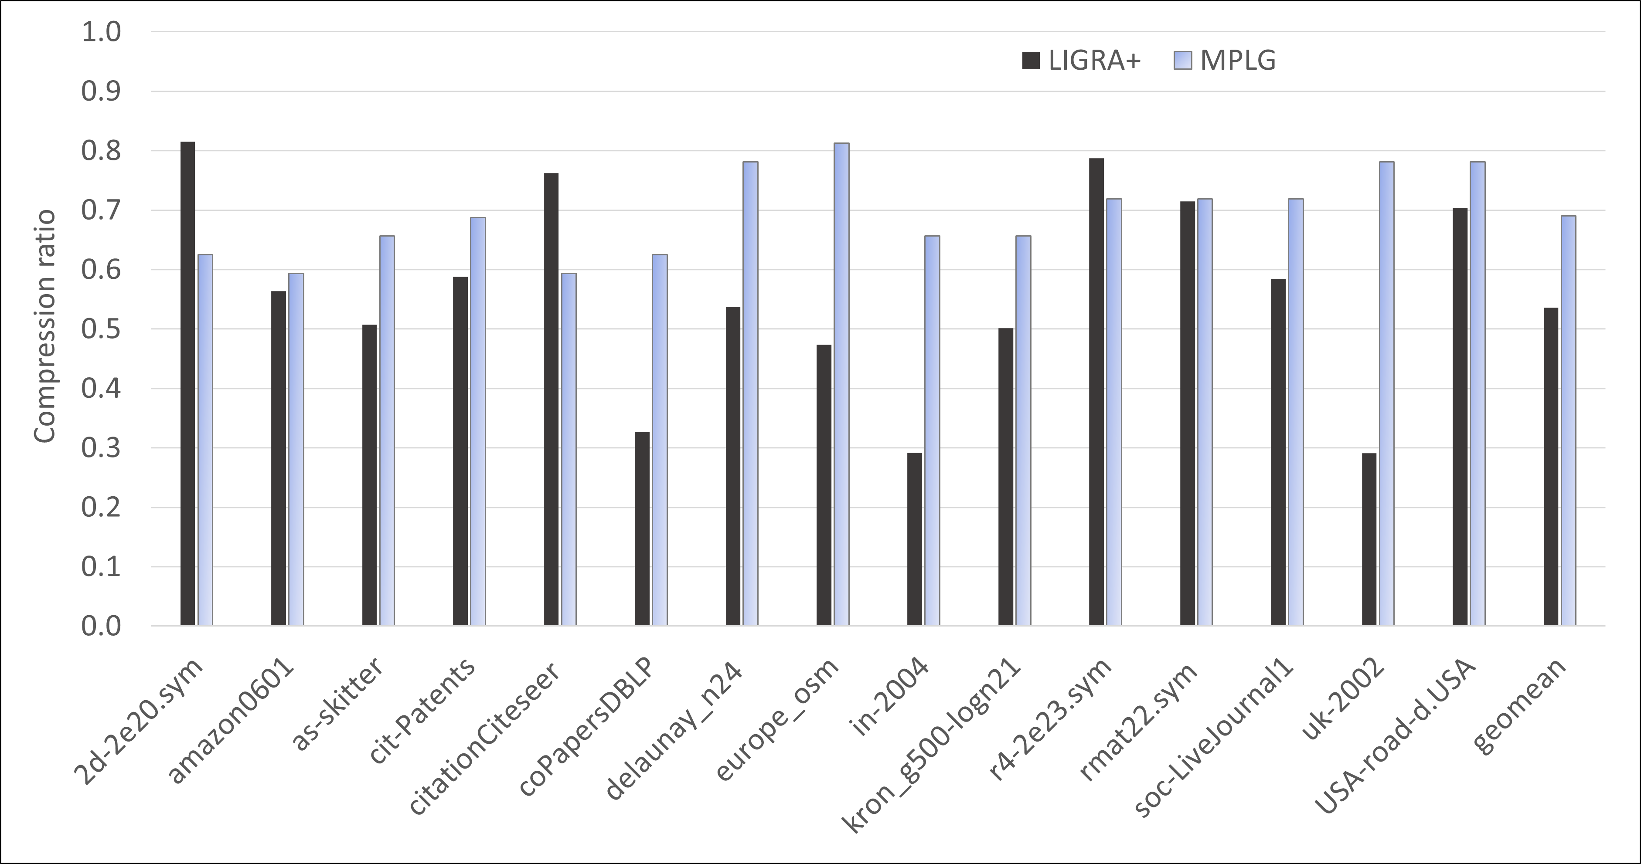
Compression Ratio Comparison
MPLG compresses some graphs better
LIGRA+ is 15% better on average

Slide 16
MPLG Speedup on RTX 3090
Median above 1.0 in all cases (i.e., speedup)
Up to 32% performance increase
Speedup on all inputs for ecl-CC and rd-BFS

Slide 17
MPLG Speedup on TITAN V
Highest median speedup of 12%
Up to 67% performance increase
Max slowdown of 38%

Slide 18
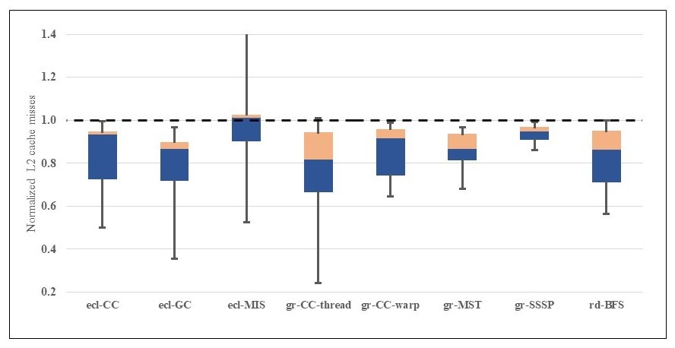
MPLG cache misses on TITAN V
Median below 1.0 in all cases (i.e., fewer misses)

Slide 19
Acceleration of Benchmark Suites
MPLG achieves several new speed records
  By adding compression to high-speed graph codes
ecl-MIS: up to 21% faster (86 billion edges / second)
ecl-CC: up to 15% faster (53 billion edges / second)
ecl-GC: up to 16% faster (16 billion edges / second)
rd-BFS: up to 22% faster (6 billion edges / second)
gr-MST: up to 8% faster (56 million edges / second)

Slide 20
LIGRA+ CILK Speedup on Xeon 6226R

Slide 21
LIGRA+ CILK Speedup on Ryzen 2950X
Median is below 1.0 in all cases (i.e., slowdown)
Up to 27% performance increase
Max slowdown of 96%

Slide 22
Summary
Compressed in-memory graph representation
  Speeds up read accesses but requires decompression
    Difficult to reap benefit, especially on GPUs with HBM
  LIGRA+ pioneered idea on CPUs
    Makes larger graphs fit in memory
    Has better compression but worse speedup than MPLG
Massively Parallel Log Graphs
  First solution to yield benefit on GPUs
  Lossless compression with log encoding down to 59%
  Accelerates high-performance GPU codes by up to 67%

Slide 23


Thank you!
Acknowledgments
  NSF, NVIDIA, and reviewers
Contact information
  noushin.azami@txstate.edu
Web page (link to paper and source code)
  http://cs.txstate.edu/~burtscher/research/MPLG/

