Slide 1


Reducing Memory-Bus Energy Consumption of GPUs via Software-Based Bit-Flip Minimization
Alex Fallin* and Martin Burtscher

Slide 2

Motivation
High-performance computing (HPC) is often power constrained
Yearly supercomputer energy usage is akin to burning tens of millions of gallons of gasoline
GPUs are highly utilized in HPC
Increasing prevalence of battery-based devices

Slide 3
Background
Many modern chips use CMOS technology
Voltage V and clock frequency f
Capacitance C depends on material & wire length
Switching activity N is how many times a bit is flipped (1 to 0 or vice versa)
The memory bus is a good target
P_{dynamic} = C • V² • N • f

Slide 4
Related Work

Slide 5
Data Bus Inversion (DBI)
Commercial solution first made available in DDR4
Requires an extra wire per byte (12.5% overhead)
Compares values at byte granularity
  If more than 4 bits differ, the bits are inverted
  Receiver looks at the DBI wire to determine which bytes to un-invert to reproduce the original byte
Previous Data | 0 | 1 | 1 | 0 | 1 | 1 | 0 | 1 | X
Next Data | 1 | 0 | 0 | 1 | 0 | 1 | 0 | 0
Next Data | 0 | 1 | 1 | 0 | 1 | 0 | 1 | 1 | 1

Slide 6
Bit-Affinity
Li et al. observe that 8T SRAM has ‘read affinity’
  Reading a ‘1’ consumes less energy than reading a ‘0’
  Create an encoding scheme for data and instructions
Lucas et al. demonstrate that there is a tradeoff
  In memory with ‘1’ bit-affinity, reducing zeros is not enough to get optimal performance
  Introduce encoding scheme, use optimum between increased affinity and decreased switching activity

Slide 7
Non-Volatile Memory (NVM)
Dgien et al. build an NVM compression scheme
  Use frequent pattern compression
  Only write bits that need to be changed
  Reducing writes can increase life of NVM
Bittman et al. observe that reducing bit flips is more important than reducing writes
  Introduce a linked-list implementation designed to reduce bit flips to extend NVM life

Slide 8
Our Approach

Slide 9
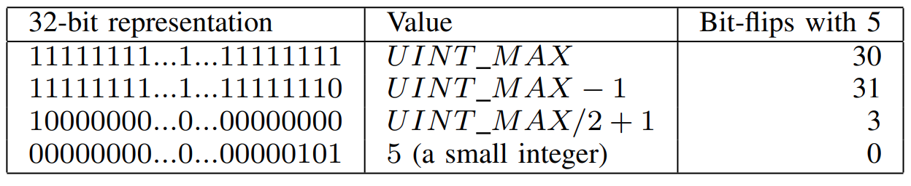
Approach – Sentinel Changes
Many codes initialize data structures with sentinels or other special values
We change these values to more closely match (in Hamming distance) the final values

Slide 10
Approach – Applicability
Approach works on wide variety of algorithms
We evaluate it on graph analytics algorithms
  Maximal Independent Set (MIS)
  All Pairs Shortest Paths (APSP)
  Breadth-First Search (BFS)
  Single-Source Shortest Path (SSSP)
Include highly-optimized versions as well as unoptimized versions

Slide 11
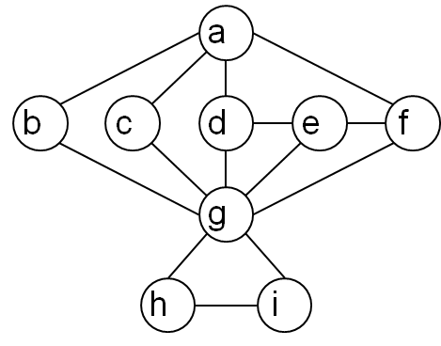
Maximal Independent Set
Both MIS codes are based on Luby’s randomized algorithm
  Label all vertices with a random number and put them in the set of possible vertices
  For each vertex, if its random number is less than its smallest neighbor, add it to the MIS
  Remove all its neighbors from the set of possible vertices
  Repeat until there are no vertices left in the set of possible vertices

Slide 12
Maximal Independent Set
Complex encoding scheme for the vertex status
  Status and random priority are combined in a byte
  Top 7 bits represent status and priority
    0 indicates out-of-set
    127 indicates in-set
    All values between 0 and 127 designate priorities
  Bottom bit is used to quickly check if a vertex is undecided
Simple code works similarly using int

Slide 13
Maximal Independent Set
We changed the encoding scheme
  The bytes for all vertices start mostly random but converge to either 0xFE or 0x00
  We change the in-set status to 0x80, undecided remains 0x00, and priorities are still 1-126
  The fast undecided check changed from val & 0x01 to val & 0x7F
Old
0 | 0 | 0 | 0 | 0 | 0 | 0 | 0
1 | 1 | 1 | 1 | 1 | 1 | 1 | 0
New
0 | 0 | 0 | 0 | 0 | 0 | 0 | 0
1 | 0 | 0 | 0 | 0 | 0 | 0 | 0

Slide 14
All Pairs Shortest Paths
The APSP codes use Floyd-Warshall algorithm
  Data structure is n-by-n matrix m, representing cost from each vertex to each other vertex
  For each edge from u to v, m[u][v] is initialized to the weight of that edge
  All other vertices are initialized to INT_MAX/2
  Code iterates over triply-nested for-loop
We replaced INT_MAX/2 with INT_MAX/4 + 1
  Has more bits in common with final distances

Slide 15
Breadth-First Search
BFS finds minimum number of hops from
a source vertex to all other vertices
  Elements are processed in graph order
  making the memory access pattern complex
  High-performance code uses 1 billion and simple code uses INT_MAX - 1 as initialization values
We replaced both values with INT_MAX/2 + 1
  Has more bits in common with final hop counts

Slide 16
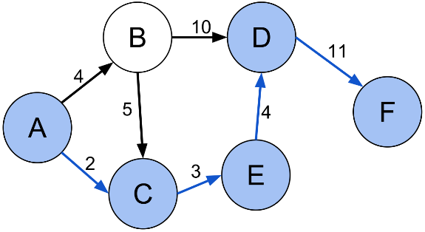
Single-Source Shortest Path
SSSP computes the minimum distance from a source vertex to all other vertices in the graph
  Both codes are topology driven and perform pull-style updates until there are no updates to be made
  Original initial values are INT_MAX/2 and INT_MAX
We changed both initial values to INT_MAX/2 + 1
  Has more bits in common with
  final distances

Slide 17
Methodology

Slide 18
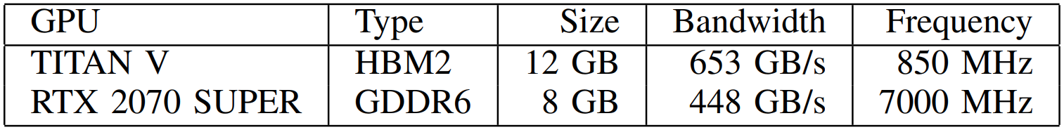
System
We ran the experiments on 2 GPUs with the following memory specifications
The TITAN V is Volta architecture and the RTX 2070 SUPER is Turing
Energy measurements collected using NVML
  Queries hardware sensor to get whole GPU energy

Slide 19
System and Software
Host system
  CPU: AMD Ryzen Threadripper 2950X
Software
  Fedora 34 operating system
  g++ version 11.2.1
  nvcc version 11.4
  CUDA driver version 470.63

Slide 20
Inputs (non-APSP)
Graph name | Type | Origin | Vertices | Edges | d_{min} | d_{avg} | d_{max}
2d-2e20.sym | grid | Galois | 1,048,576 | 4,190,208 | 2 | 4.0 | 4
amazon0601 | co-purchases | SNAP | 403,394 | 4,886,816 | 1 | 12.1 | 2,752
as-skitter | Int. topology | SNAP | 1,696,415 | 22,190,596 | 1 | 13.1 | 35,455
citationCiteseer | pub. citations | SMC | 268,495 | 2,313,294 | 1 | 8.6 | 1,318
cit-Patents | pat. citations | SMC | 3,774,768 | 33,037,894 | 1 | 8.8 | 793
coPapersDBLP | pub. citations | SMC | 540,486 | 30,491,458 | 1 | 56.4 | 3,299
delaunay_n24 | triangulation | SMC | 16,777,216 | 100,663,202 | 3 | 6.0 | 26
europe_osm | road map | SMC | 50,912,018 | 108,109,320 | 1 | 2.1 | 13
in-2004 | web links | SMC | 1,382,908 | 27,182,946 | 0 | 19.7 | 21,869
internet | Int. topology | SMC | 124,651 | 387,240 | 1 | 3.1 | 151
kron_g500-logn21 | Kronecker | SMC | 2,097,152 | 182,081,864 | 0 | 86.8 | 213,904
r4-2e23.sym | random | Galois | 8,388,608 | 67,108,846 | 2 | 8.0 | 26
rmat16.sym | RMAT | Galois | 65,536 | 967,866 | 0 | 14.8 | 569
rmat22.sym | RMAT | Galois | 4,194,304 | 65,660,814 | 0 | 15.7 | 3,687
soc-LiveJournal1 | j. community | SNAP | 4,847,571 | 85,702,474 | 0 | 17.7 | 20,333
uk-2002 | web links | SMC | 18,520,486 | 523,574,516 | 0 | 28.3 | 194,955
USA-road-d.NY | road map | Dimacs | 264,346 | 730,100 | 1 | 2.8 | 8
USA-road-d.USA | road map | Dimacs | 23,947,347 | 57,708,624 | 1 | 2.4 | 9

Slide 21
Experiments
We applied the described sentinel changes
For each program we query the GPU energy sensor before and after execution of both the original kernel and the bit-flip optimized kernel
The difference in these values gives us the energy consumption of the whole GPU for the time the kernel was running

Slide 22
Experiments
The kernels were run in a loop for 10 seconds
The bit-flip optimized and the original kernels were run interleaved
Results evaluated with a paired t-test (α = 0.05)
  95% confidence in true difference
We calculate 10 consumption ratios for each input
We report ratios in a box and whisker plot

Slide 23
Results

Slide 24
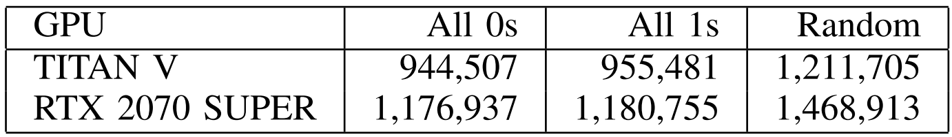
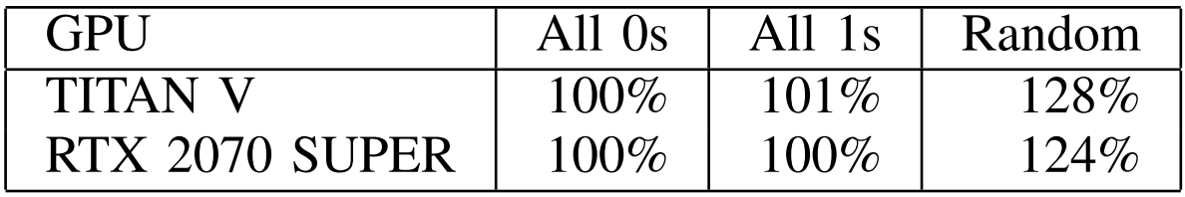
Data Transfer Experiments
Absolute consumption values (millijoules)
Consumption ratio vs All 0s

Slide 25
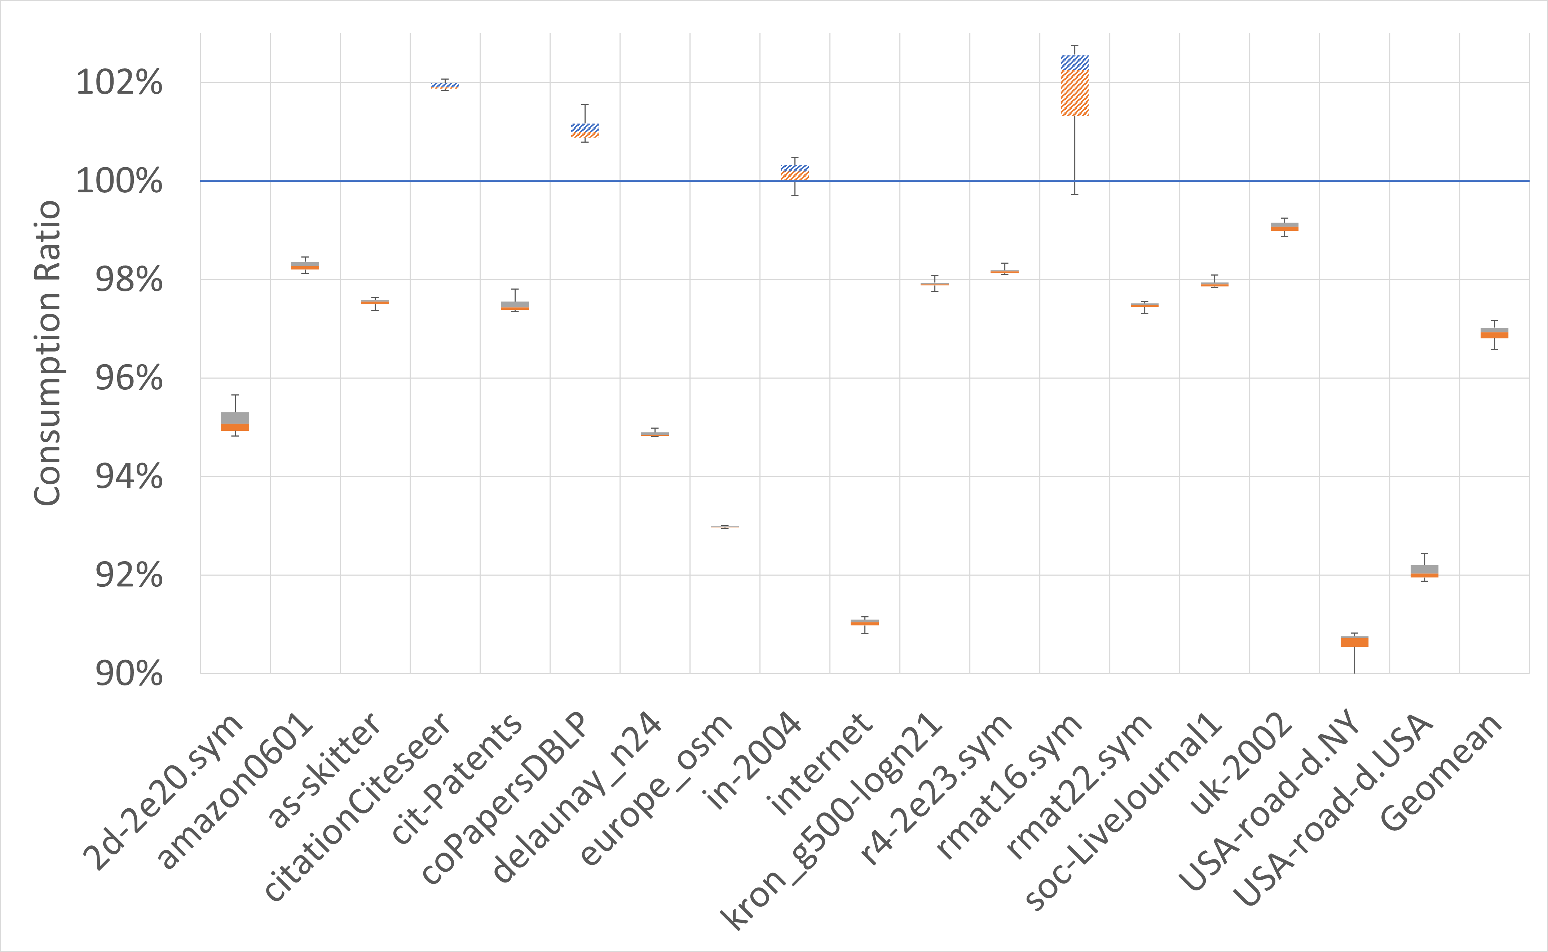
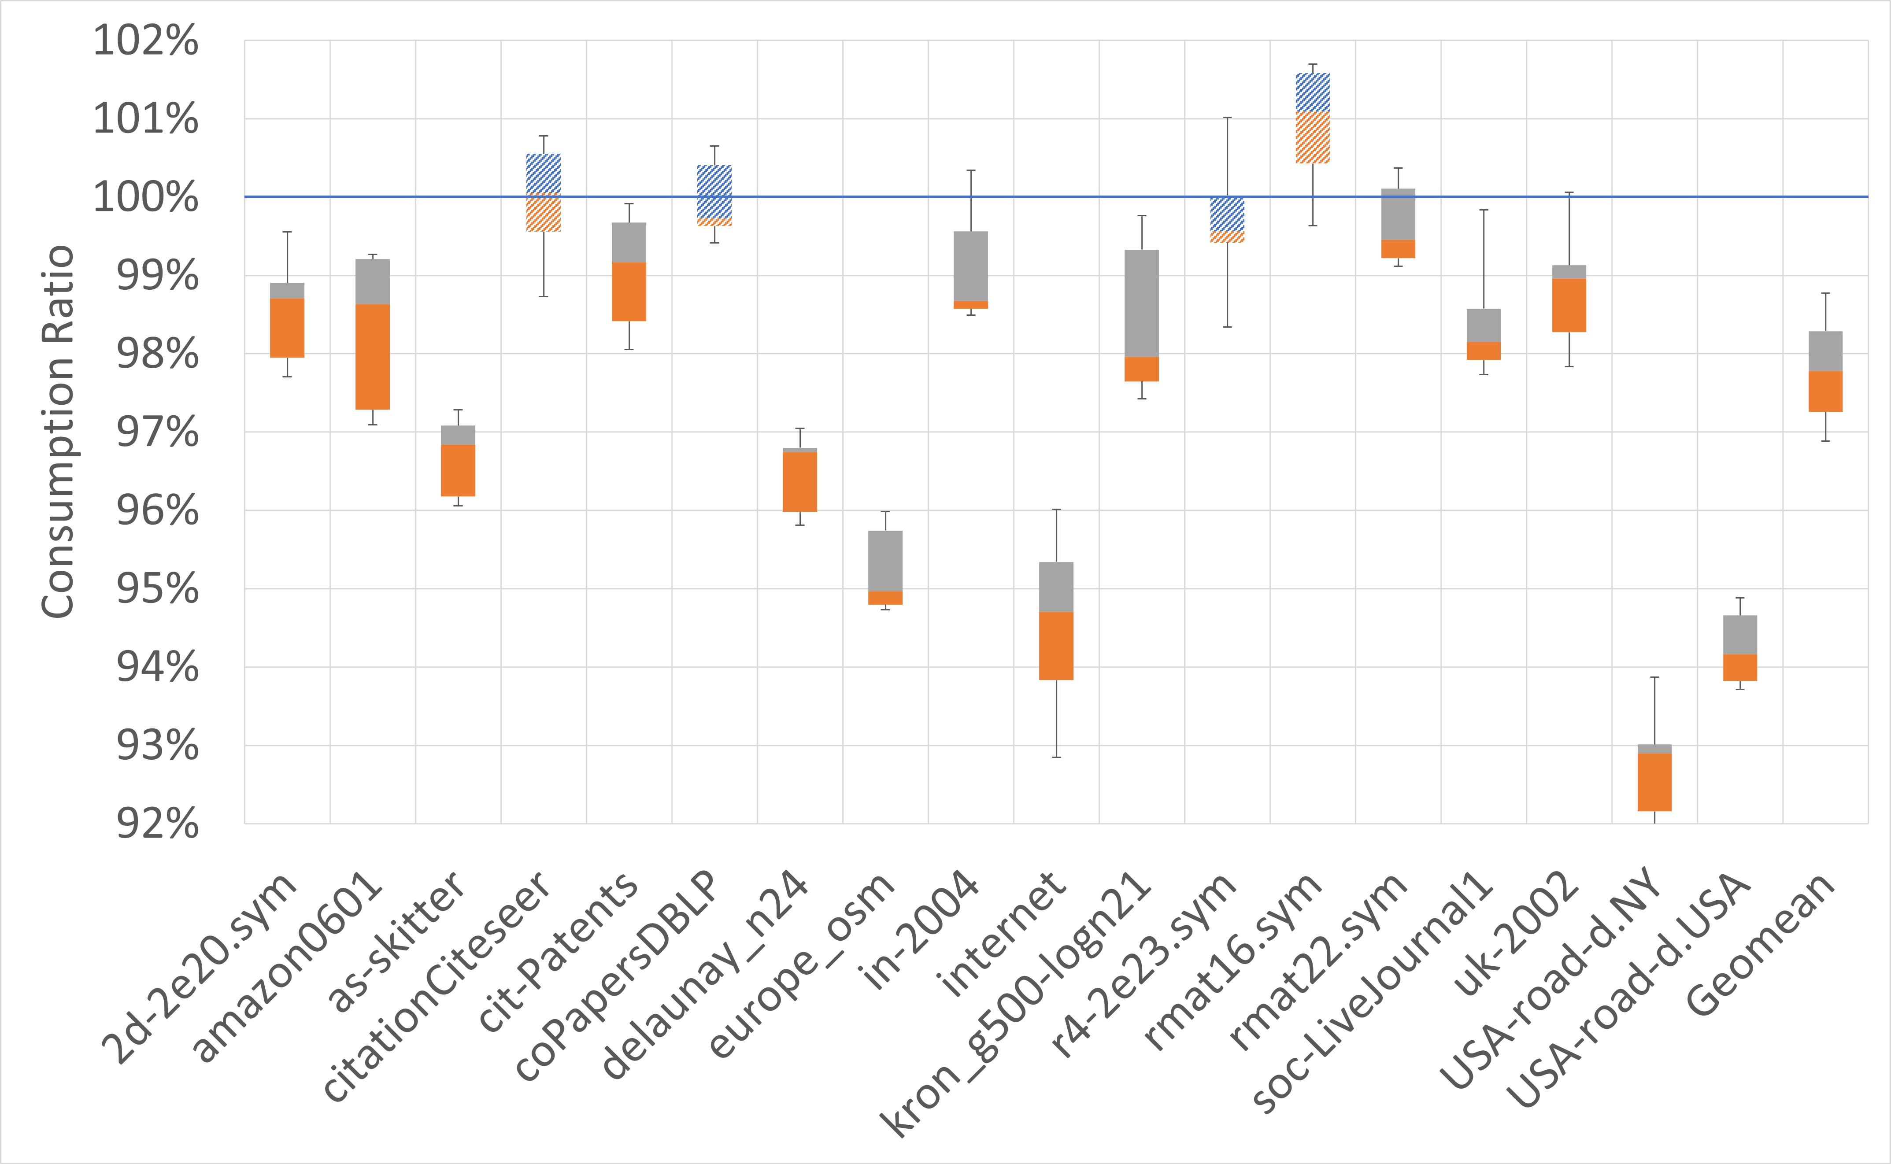
Simple MIS
TITAN V
RTX 2070
-1.7%
-2.7%
2.2%
3.1%
10.6%
8.3%

Slide 26
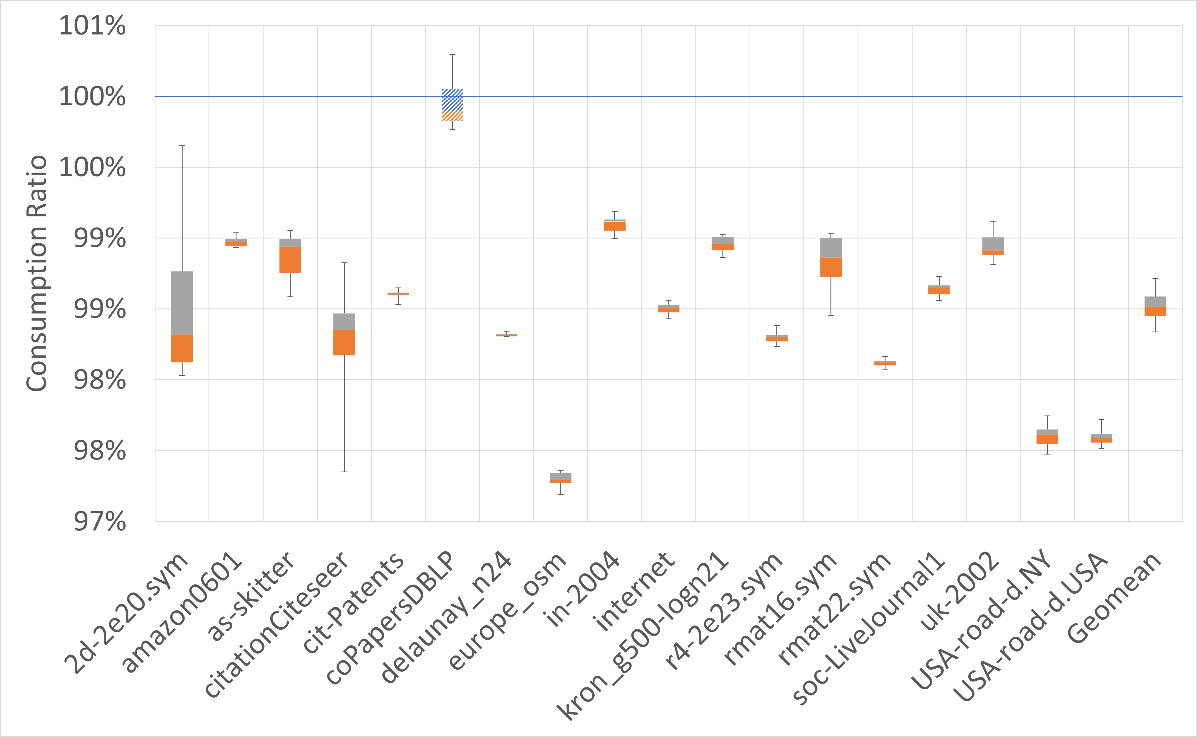
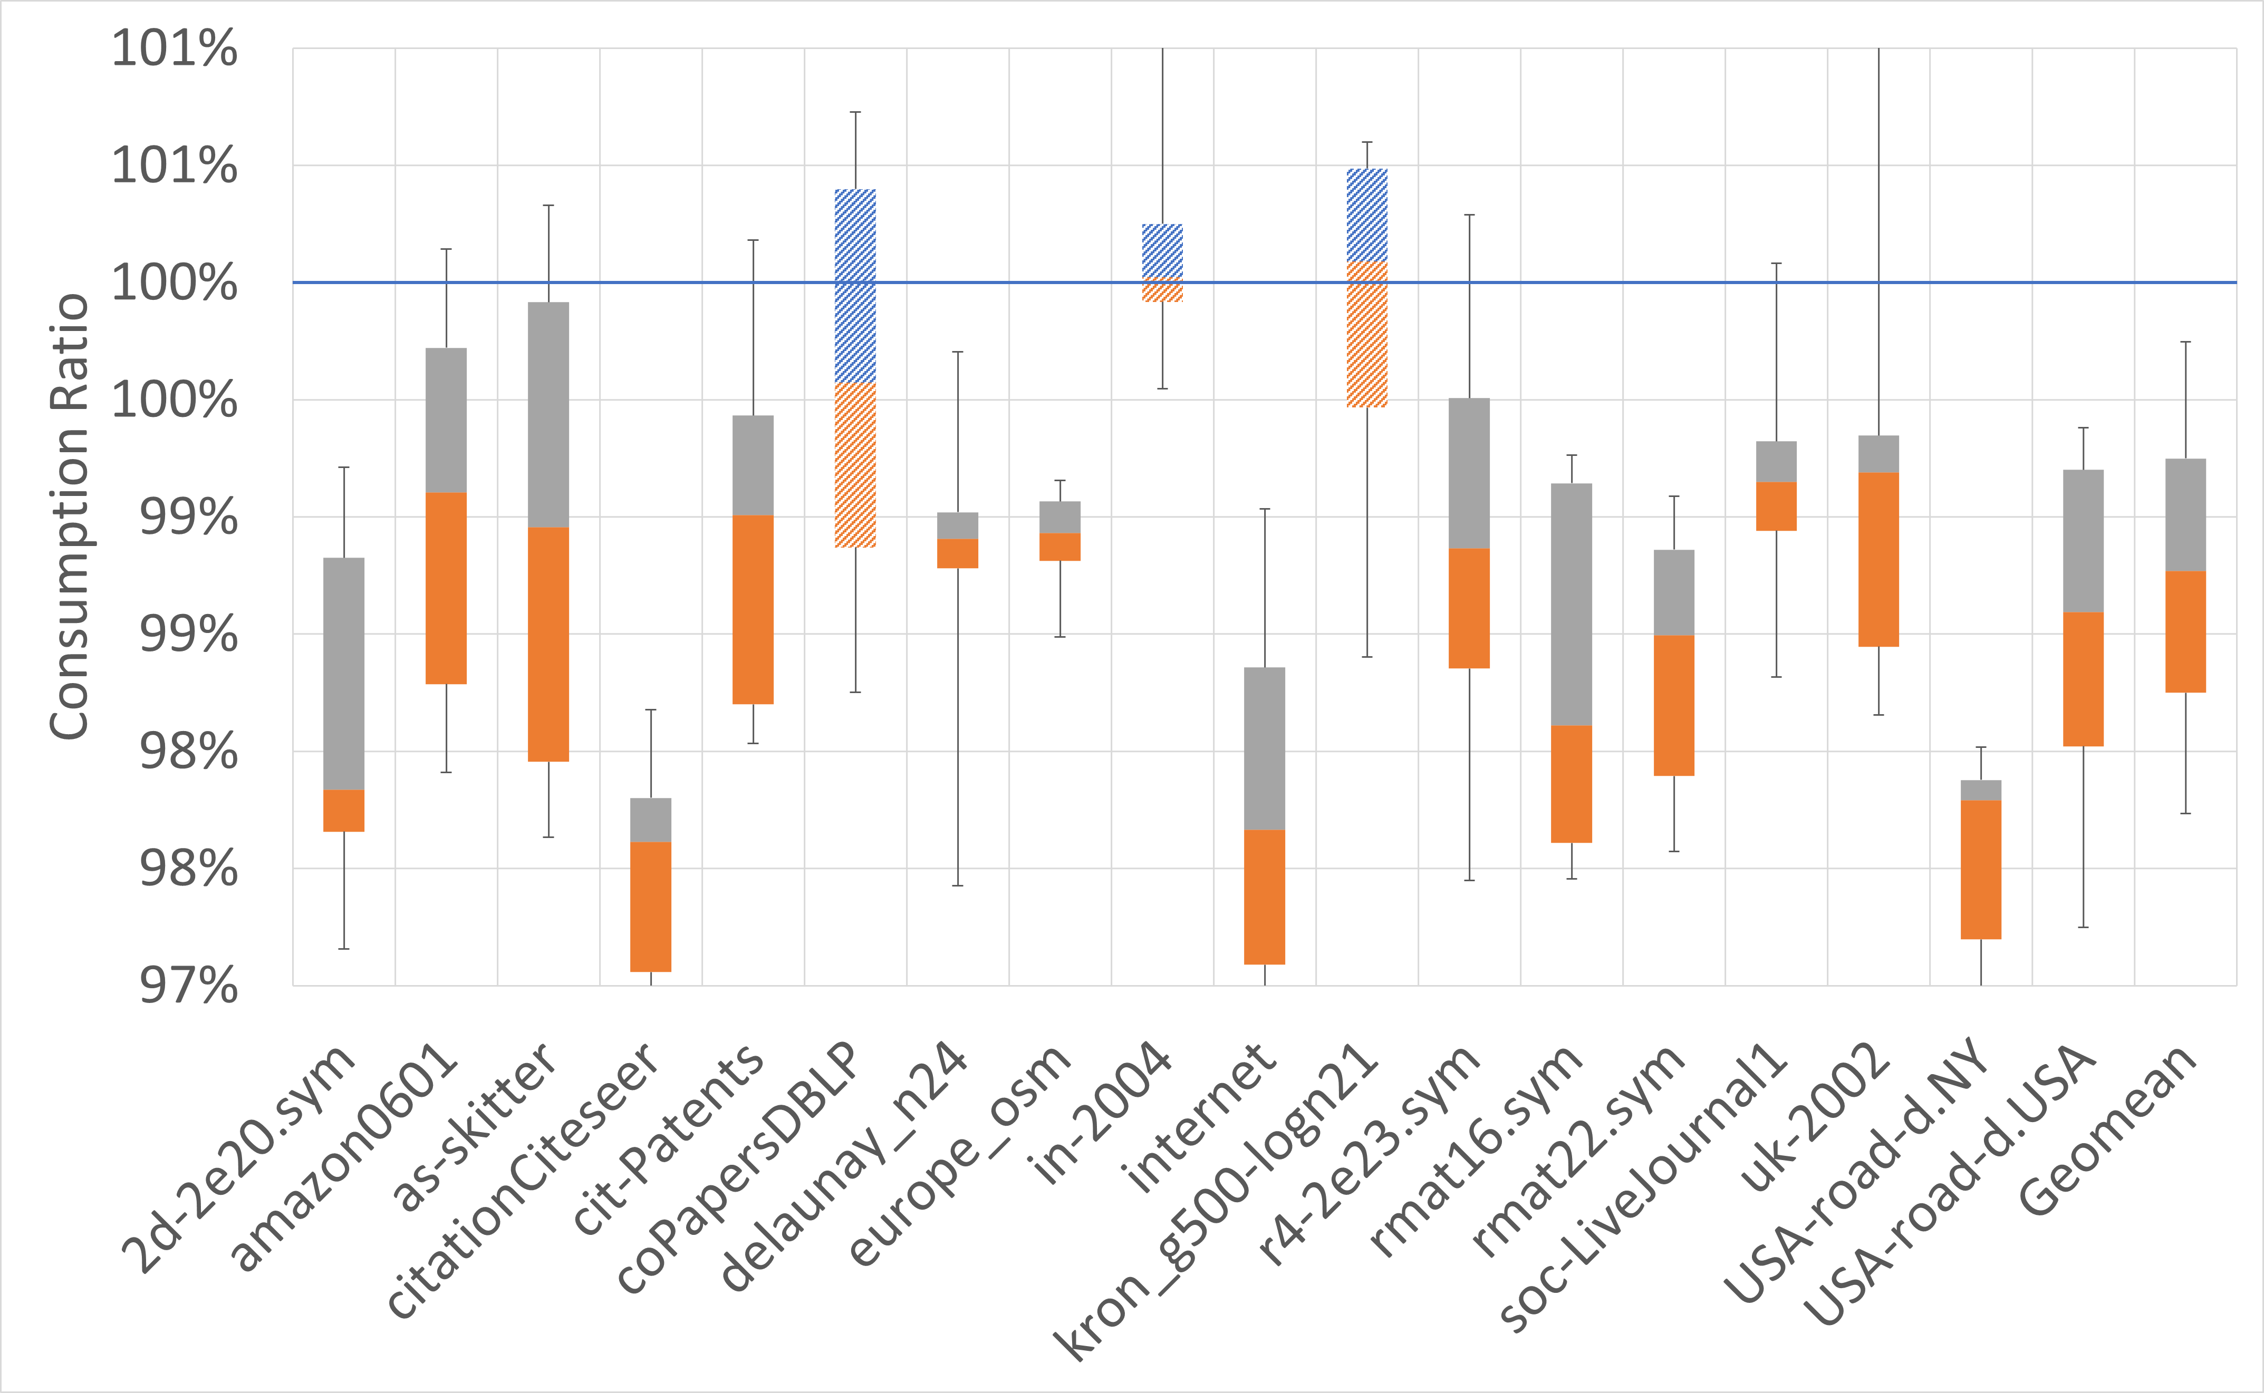
ECL MIS
TITAN V
RTX 2070
-0.3%
-1.1%
1.2%
1.5%
2.8%
3.4%

Slide 27
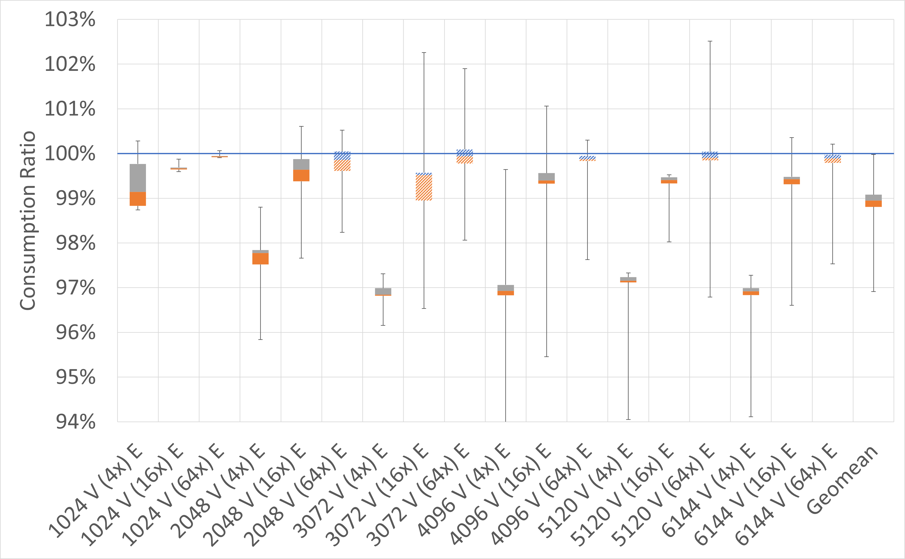
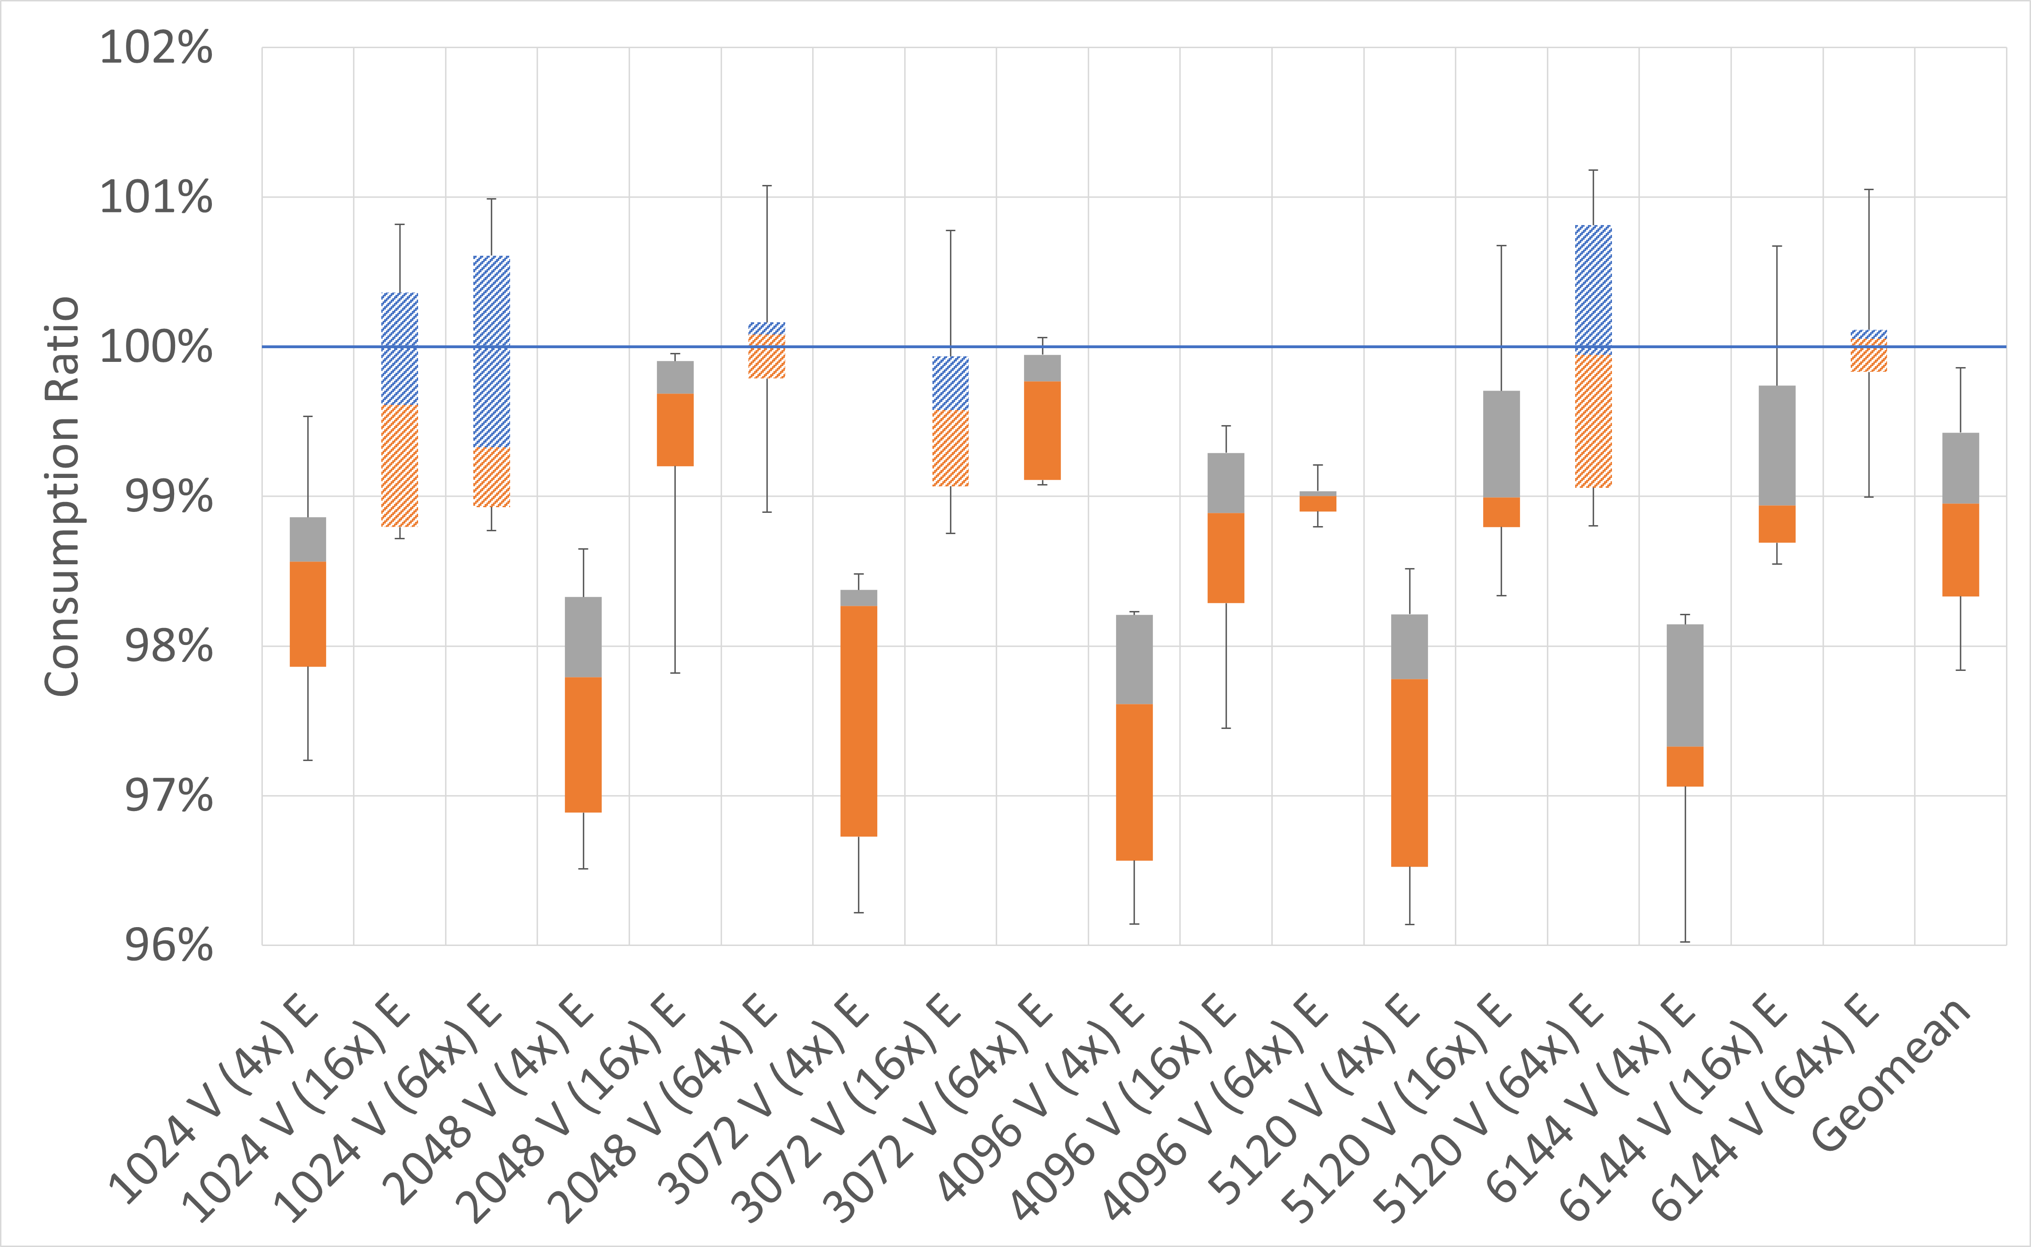
Simple APSP
TITAN V
RTX 2070
1.1%
1.0%

Slide 28
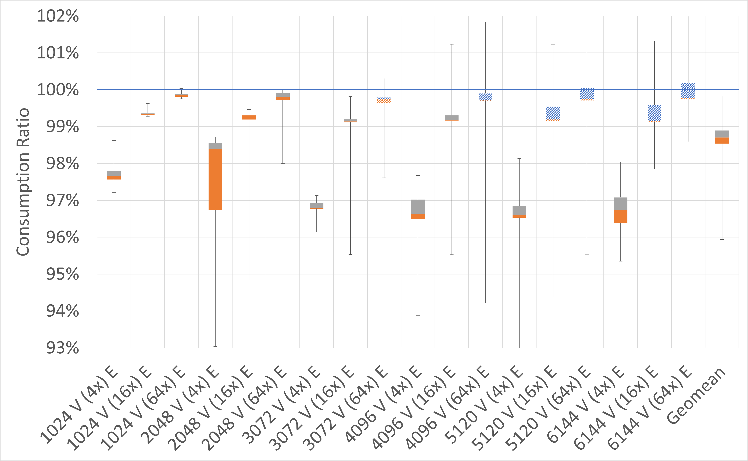
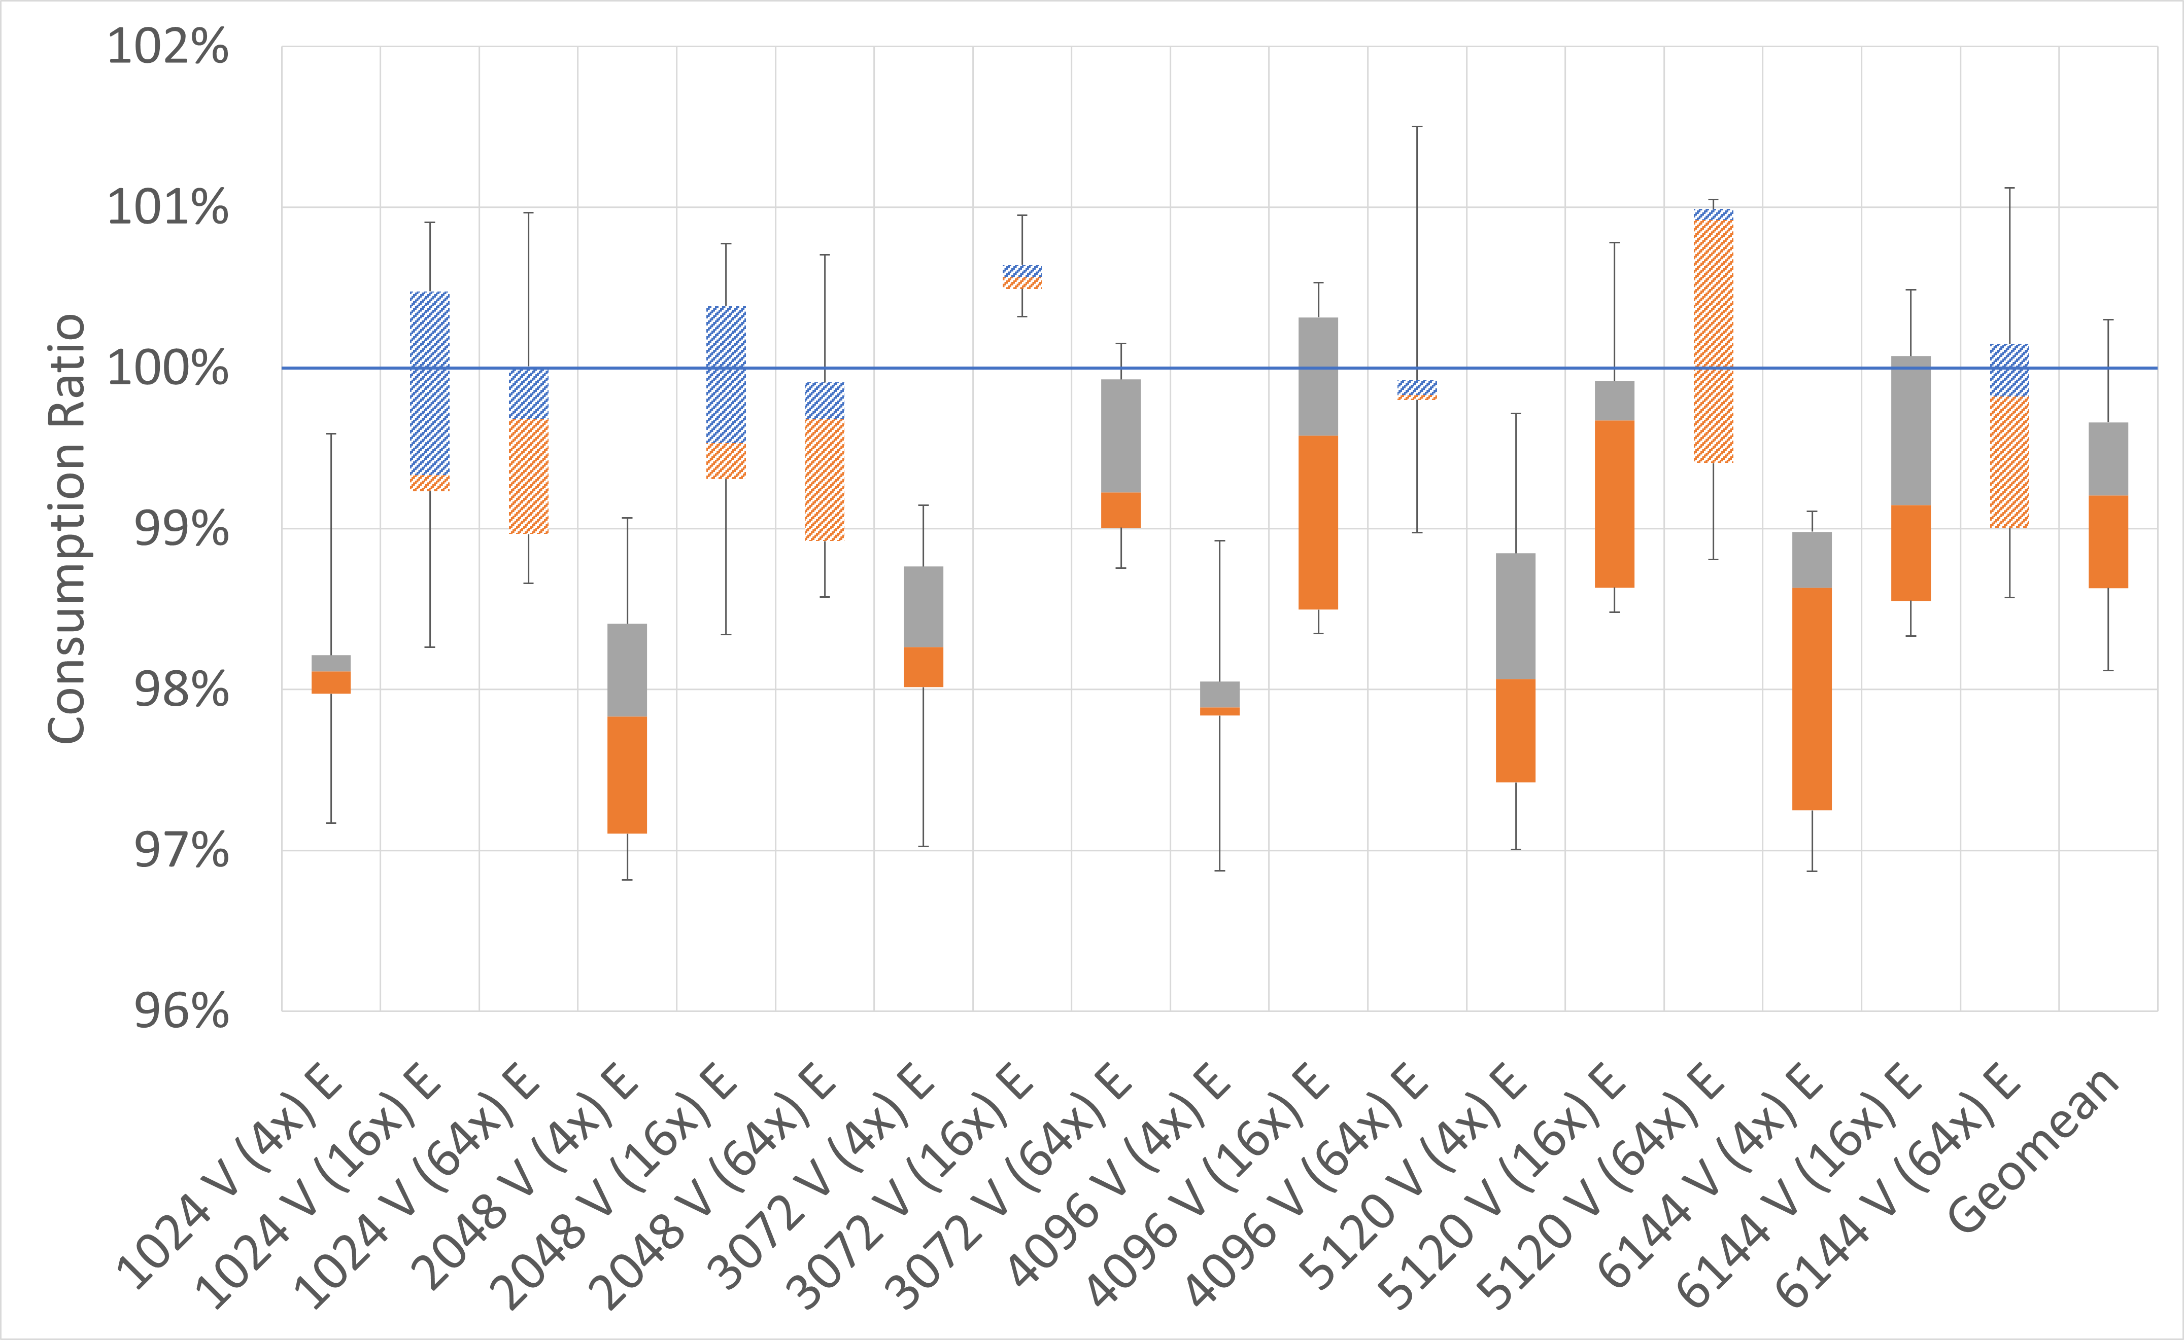
ECL APSP
TITAN V
RTX 2070
0.8%
1.3%

Slide 29
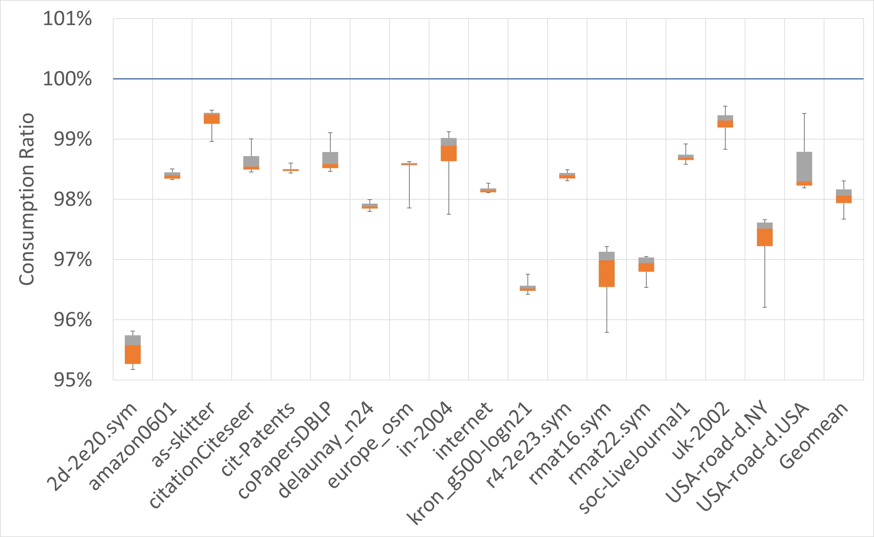
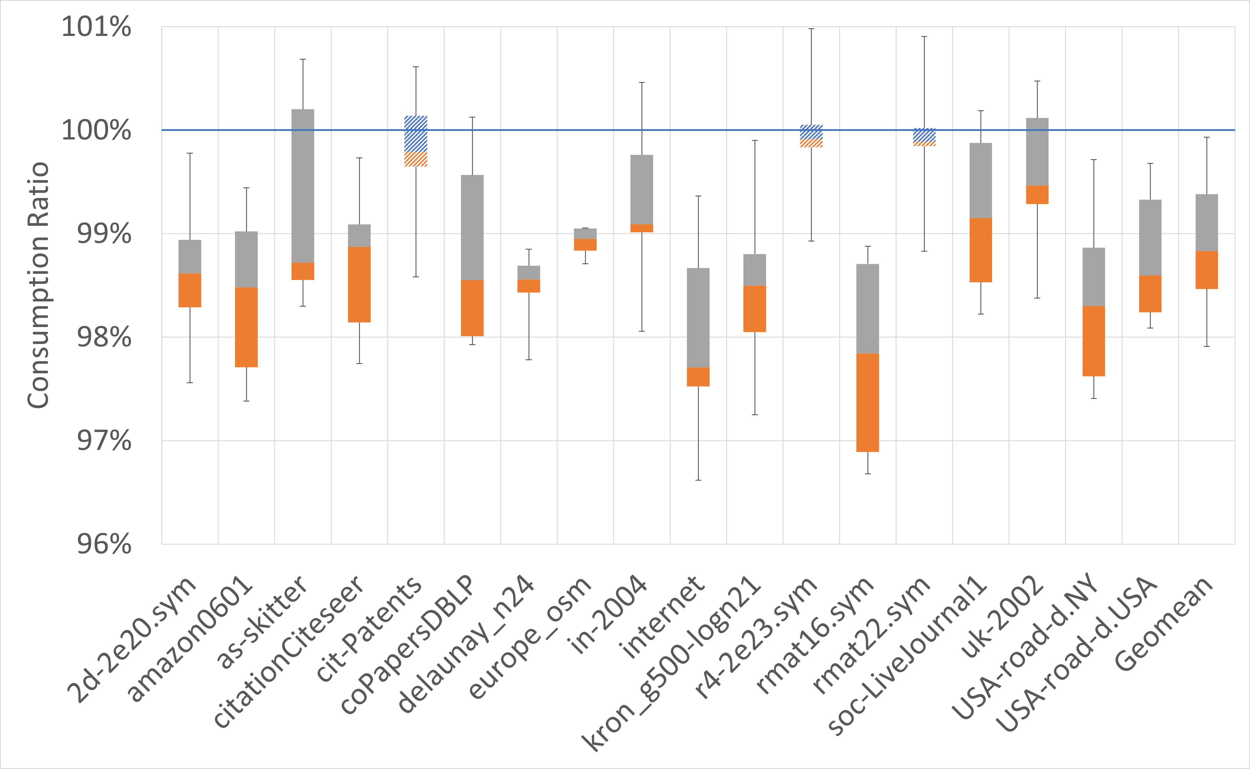
Simple BFS
TITAN V
RTX 2070
1.2%
1.9%

Slide 30
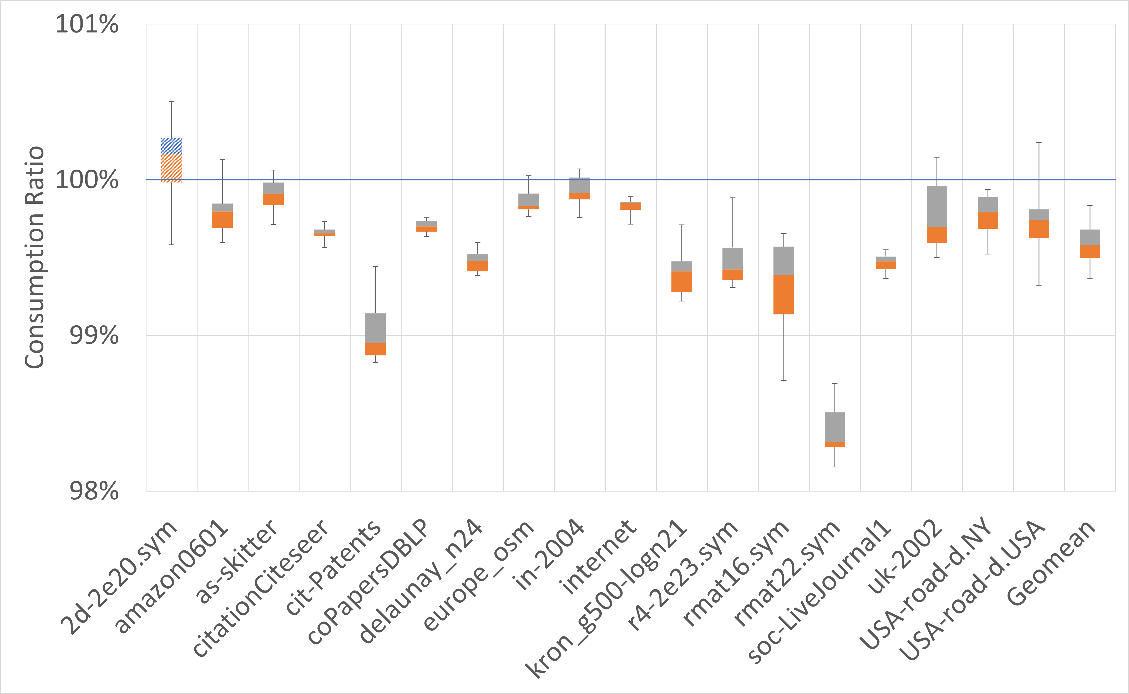
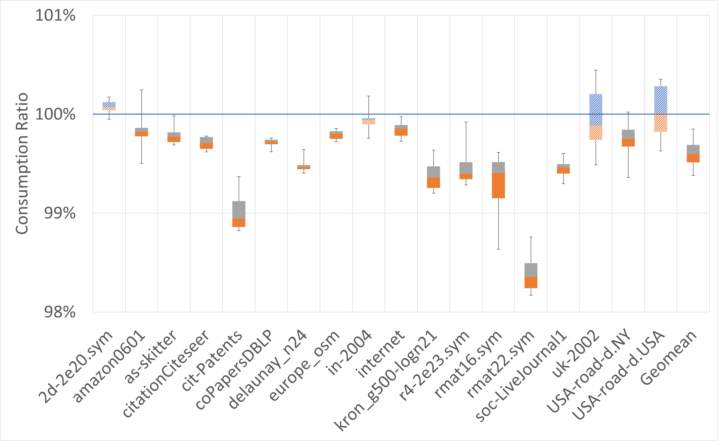
Gardenia BFS
TITAN V
RTX 2070
0.4%
0.4%

Slide 31
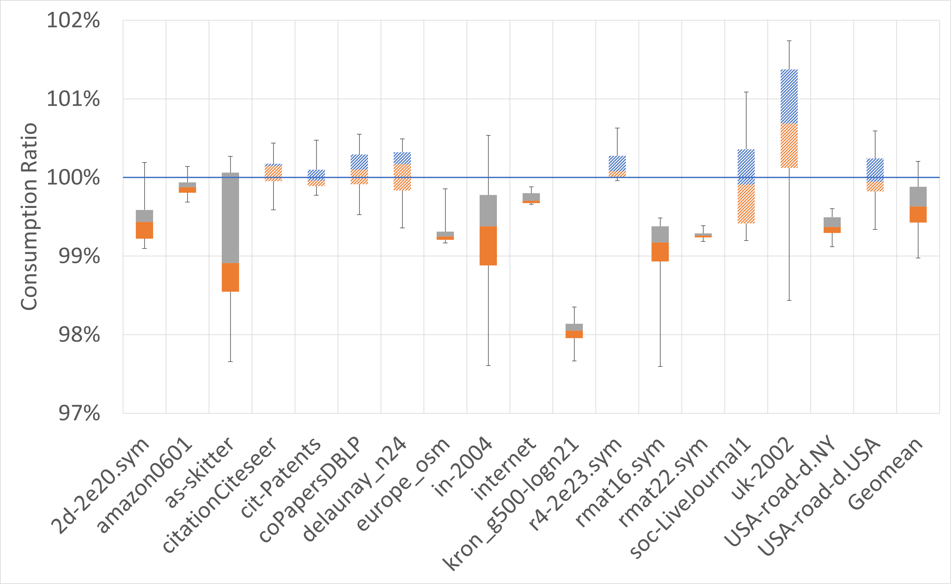
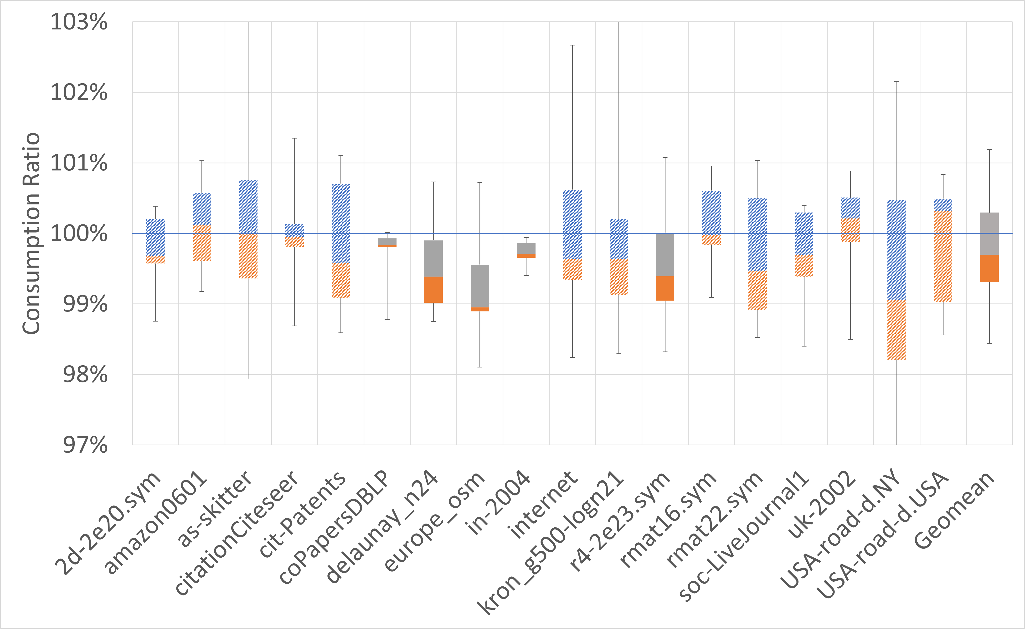
Simple SSSP
TITAN V
RTX 2070
0.3%
0.4%

Slide 32
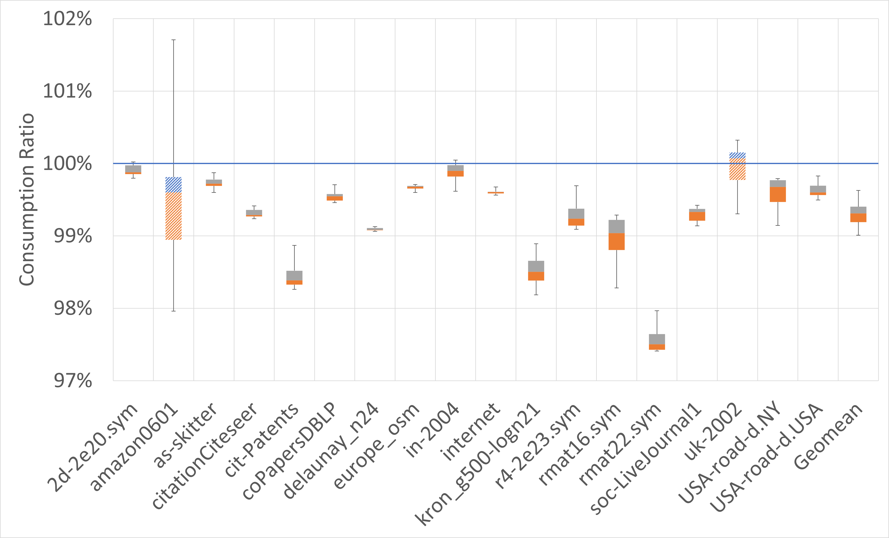
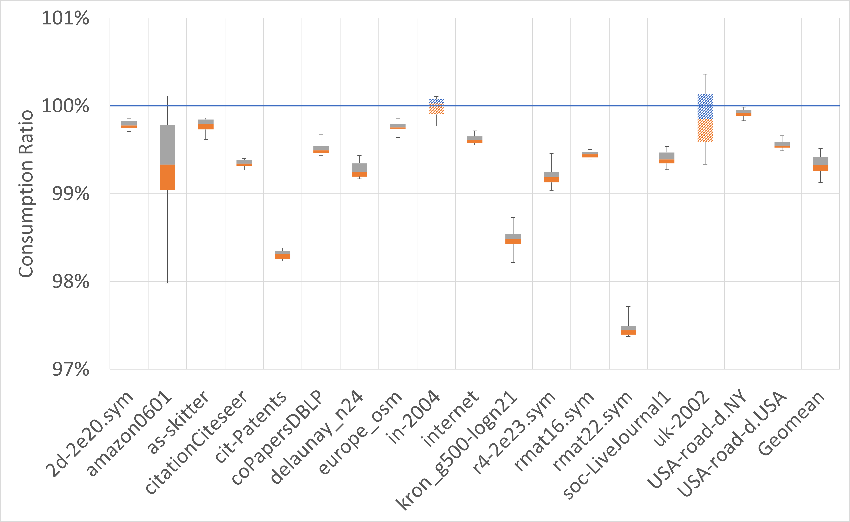
Gardenia SSSP
TITAN V
RTX 2070
0.7%
0.7%

Slide 33
Result Summary
All four high-performance codes yield statistically significant energy savings on average
All four simple programs also yield noticeable energy savings on most inputs
Variance is generally high, potentially due to access reordering and timing behavior
Changes do not affect runtime or correctness of the codes

Slide 34
Conclusion
In CMOS chips, reducing bit-flips can reduce energy consumption
Using fixed-size buffers we found that random data required 28% and 24% more energy on a TITIAN V and an RTX 2070 Super, respectively
We show that strategic selection of sentinel values in both high-performance and simple CUDA codes can significantly lower energy

Slide 35
Thank you!
Contact information
  waf13@txstate.edu
Web page (link to paper and bit-flip codes)
  https://cs.txstate.edu/∼burtscher/research/bit-flips/

